Slide 1
Engineering design 2026
Lecture Week 2
Deck 1
Systems and the Engineering thereof
Prof Henri Marais
22 Jul 2025

Slide 2
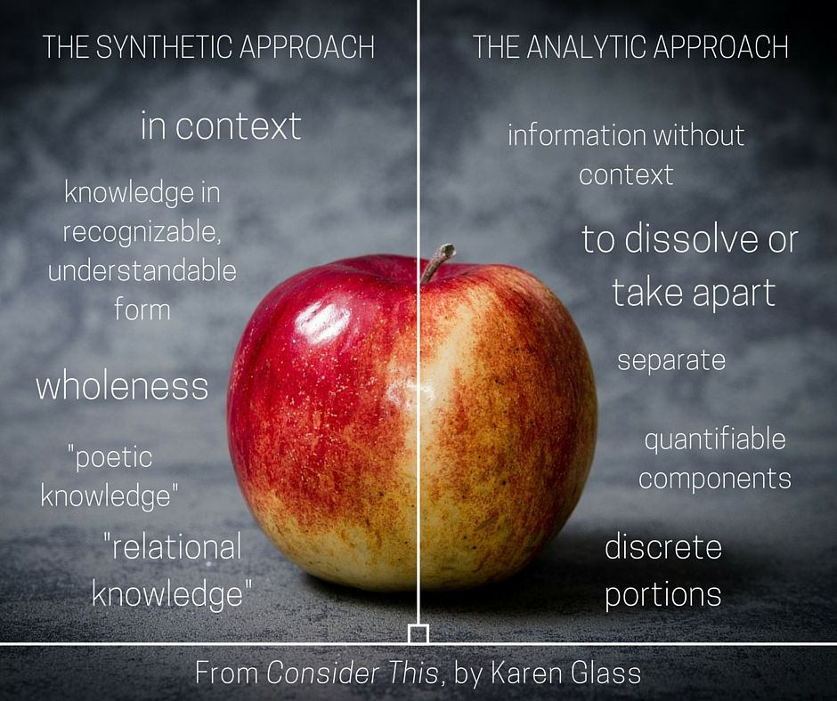
Same apple different views
Notes:
It should be obvious that neither analytic thinking nor synthetic thinking alone would be sufficient to design truly well functioning systems. The synthetic side would gloss over some of the (maybe very important) low-level detail whilst the analytic approach might fail to consider the environment in which the system should operate.
Consider the following: If you were to design a 5V power supply which type of thinking would you naturally lean towards? Most likely analytical thinking and that would quickly lead to some process or procedure that you learned in electronics... That might be perfectly fine for a lab practical but how would the design need to change if
The power supply was to be used in very cold climates such as the arctic?
Very hot climates were more realistic, say for instance the Namib dessert?
What if it were to be used in life saving medical devices?
As you can see the context in which a system is used, is just as important than the technical implementation details.

Slide 3

Analytical thinking
Take thing to be explained apart
Explain each of the components
Aggregate component descriptions
Notes:
Analytical thinking is required to understand how thigs work, and that is typically what engineers are concerned with (initially at least).

Slide 4
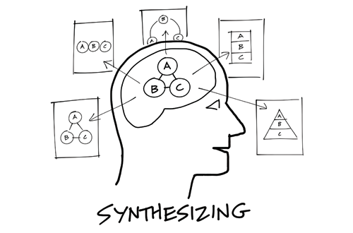
Synthetic Thinking
Identify a system containing the system of interest
Explain the behaviour of the containing system
Disaggregate behaviour to system of interest’s function
Notes:
Synthetic thinking on the other hand is concerned with identifying how systems (or sub-systems) are related to other systems, the environment, and itself. By using synthetic thinking you are trying to understand behaviour and from those behaviour(s) identify functionality.

Slide 5


Systems Thinking
Systems must be understood in the context of what they can do in the world in which they will do it.
A systems view is not simply a sum of the component parts
Systems view is that a collection of parts must be seen as a functioning whole
Notes:
The collection of parts is commonly seen as a system. At MOST this is a collection or set of parts. If there are no explicit mention of interactions, systems thinking is not evident.

Slide 6
Classification of system terminology
A system is composed of sub-system(s)
Isolated sub-system becomes a system containing other sub-systems
Notes:
Systems thinking is hierarchical in nature, and since SE is based on systems thinking so too is our perspective. Any isolated system will be a sub-system of a larger system and contain one or more sub-systems. It is important to note that for engineered systems this perspective has practical limitations. We’ll delve into those details later on.

Slide 7
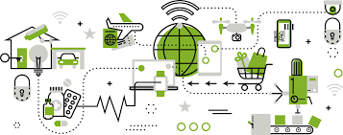
What system?
A system is a construct or collection of different elements that together produce results not obtainable by the elements alone.
The value added by the system as a whole, beyond that contributed independently by the parts, is primarily created by the relationship among the parts; that is, how they are interconnected
Notes:
Think about this carefully. A system is not just a collection of parts! If you take away the interactions between the parts the entire system collapses. Although this is a simple concept to grasp, it is much more complex in practice.

Slide 8
What is a system? (formally)
Combination of functionally related items forming a unitary whole
Specific behaviour due to functional relationships
A system is more than a sum of the parts!

Slide 9
A graphical representation…
Constraints
Outputs
Inputs
SYSTEM
ENVIRONMENT
Interaction
System Scope
Boundary
Notes:
On an abstract level this represents a system. Every system has some “world” in which it exists and over which it can exercise some form of control. This is referred to as the system scope.
Anything that falls outside of the system scope is considered the environment and this might be a physical environment / information environment / social environment etc.
Finally, a system shall produce some form of output, based on certain inputs and subject to constraints.

Slide 10
System: Elements
Components
What the system is made up of
Attributes
Properties of the parts and the system as a whole
Relationships
Results of engineering efforts (man-made systems)
Notes:
Note that the relationships cannot exist in isolation and requires components. Since we need to describe the components certain attributes are used. The attributes vary from component to component. You should be familiar with some attributes of electronic components such as a resistor’s (component) resistance (attribute), power dissipation rating (attribute) and physical size (attribute). As components become more abstract so too does the attributes. However, the principle remains.

Slide 11
System: Elements
State
Situation of the system at a specific point in time
Behaviour
How states changes over time
Process
All of the behaviours of the system over time
Increasing Complexity
Notes:
On an abstract level, once parts have been assembled into a system such a system has a specific state.
A state is an attribute of the system that can be observer (think of a state of being). Human beings can be in an awake state or asleep state
A system behaviour is simply the changing system states over time. For the human example waking up can be a behaviour as it moves the human system from one state to another.
Finally, a system process is all of the system’s behaviours over time. This is a complex problem since not all behaviours occur on the same times scales. This aspect is not something that we consider in this module.

Slide 12
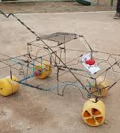
Practical example
COMPONENTS
Body / Chassis
Steering mechanism
Wheels
RELATIONSHIPS
Between the soil / surface and the wheels
Between the steering mechanism and the wheels
- Between the steering mechanism, the body
Notes:
Consider this example of a “draadkar” system. Sure, it is simplistic, but it illustrates the point. From a parts view this is a bunch of wire and some wheels. But if you assemble (thus add relationships) the individual parts utility emerges and you have a vehicle that can be steered around. Removing some of the wheels might not render the vehicle completely useless but certainly diminishes the value of the system (toy car) in this case.

Slide 13
So a system
is Hierarchical
01
has a SINGLE objective
02
composed of
Components, Attributes, and Relationships
03
has Emergent properties that is more than sum of parts
04

Slide 14
Systems Engineering
“Systems Engineering is an engineering discipline whose responsibility is creating and executing an interdisciplinary process to ensure that the customer and stakeholder's needs are satisfied in a high quality, trustworthy, cost efficient and schedule compliant manner throughout a system's entire life cycle.”
INCOSE
Building solutions that meet customers’ needs
Notes:
This definition clearly defines the role of systems engineering in the design process. Clearly the focus is on delivering systems that provide value to the customer / stake-holder and not purely systems that make use of the latest and greatest technology.

Slide 15
What’s in a name
Engineering: discipline for transforming scientific concepts into cost-effective products through the use of analysis and judgment.
Engineering of a System: engineering discipline that develops, matches, and trades off requirements, functions, and alternate system resources to achieve a cost-effective, life-cycle-balanced product based upon the needs of the stakeholders.
Model-Based Systems Engineering (MBSE): the formalized application of modeling to support system requirements, design, analysis, verification, and validation activities beginning in the conceptual design phase and continuing throughout development and later life cycle phases

Slide 16
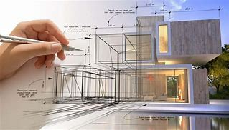
about design…
de-sign (di-zin’) v. - signed, - sign.ing, - signs. —tr. 1. To conceive in the mind; invent: designed his dream vacation. 2. To form a plan for: designed a marketing strategy for the new product. 3. To have a goal or purpose; intend. 4. To plan by making a preliminary sketch, outline, or drawing. 5. To create or execute in an artistic or highly skilled manner. –intr. 1. To make or execute plans. 2. To create designs. –n. 1. A drawing or sketch. 2. The invention and disposition of the forms, parts, or details of something according to a plan. 3. A decorative or artistic work. 4. A visual composition; pattern. 5. The art of creating designs. 6. A plan; project. 7. A reasoned purpose; intention. 8. Often designs. A sinister or hostile scheme: He has designs on my job…
Notes:
On the dictionary definition of design alone it is clear that design is not a singular activity. Yes it will be sketches and drawings but note that “execution of plans” is included. So one could say th

Slide 17
Engineering Design (working definition)
Engineering design is the disciplined, purposeful process of transforming scientific and technical concepts into cost-effective, value-generating solutions through the application of analysis, engineering judgment, and creativity.
It is rooted in engineering principles, using systematic reasoning to move from abstract ideas to practical implementations.
Within a systems context, it involves defining and refining requirements, evaluating trade-offs, and aligning functions, components, and resources to meet stakeholder needs across the product life cycle.
It encompasses the planning, execution, and documentation of this transformation — combining intent, structure, and iteration to create designs that are feasible, effective, and adaptable.
Notes:
From this one can clearly identify that

Slide 18
Engineered Systems
A system that is brought into being by a concerted and managed engineering activity.
Any system has one and only one purpose
Engineering a system means
Determining the system’s purpose or objective
Determining how well the system must perform the objective
This is the most complex aspect of engineering a system
Notes:
An Engineered system is one that is purposefully and by concerted effort established to address a certain need. Although there are many types of systems (biological systems, social systems, solar systems) our focus here is on the engineered variant.
A system has one and ONLY one purpose. It might have many sub-objectives / purposes but there is only a single purpose for the system. If you think about a transport system the objective of the system is to transport items from point A to point B. Sure, there might be some rail transport, some air transport, some cycling etc. and we might need to move cargo and/or passengers, BUT the main purpose remains.
The aspects listed under engineering a system is deceptively difficult. It is typically not straight forward to determine the exact purpose of a system. However, determining how well a system should perform its purpose is probably the most complex of the systems engineering activities. We will spend a considerable amount of time on this matter in EEII327 / REII327.

Slide 19
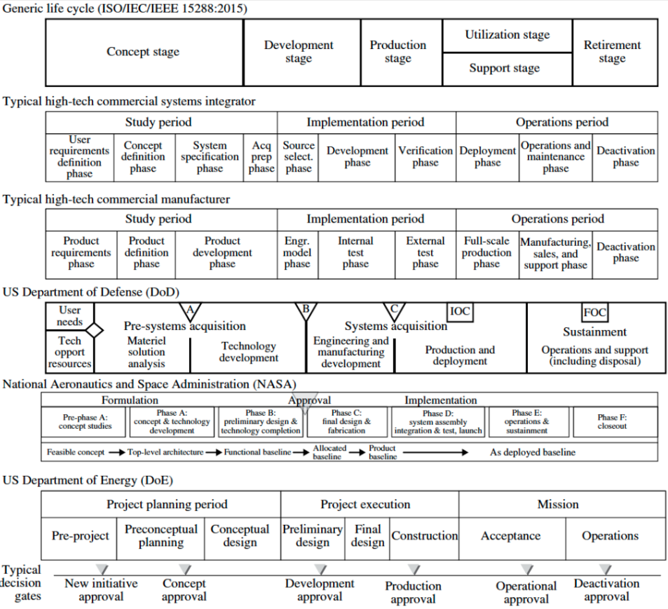
Life Cycles
In engineering design we ‘design for’ operations and conduct retirement but only implement up to external test phase
XDM
XDM – Experimental Development Model
EDM
Used to test concepts / designs / plans
May be simulation, mocks, samples, etc.
PPP
Engineering Design
Examination Point
EDM – Engineering Design Model
Embodiment of the system used to verify / text
Functionality of the solution.
Typically constructed by engineering talent
Pre-production Prototype
Used to verify production capabilities.
Designed for long in advance.

Slide 20
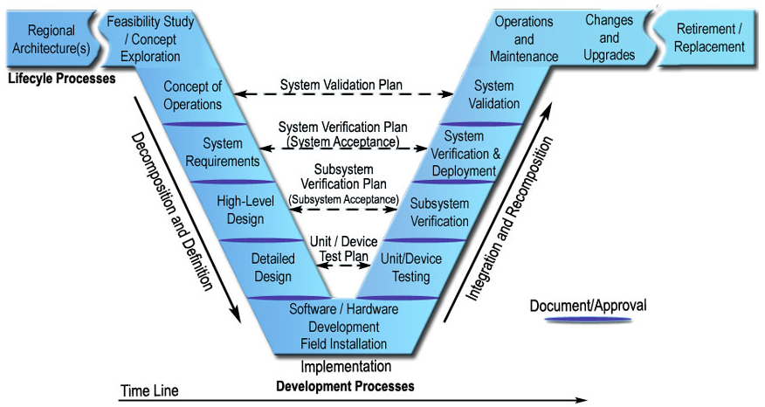
The Vee Model
Notes:
In a typical systems engineering process a significant amount of time is spent on the left side of the Vee. Ideally every step is signed off and unchangeable before moving onto the next step. For example only once the concept of operation (ConOps) has been signed off will system requirements development start to take place. Bear in mind that specialist engineering (CE/EE/ME) only takes place at the bottom of the Vee (the pivot) in the traditional approach.
While this works for systems that can be well defined and that uses mature technology (think spacecraft) there is a hidden danger in that the systems engineer(s) must be sufficiently well versed in the technical aspects such that specifications are not impossible to achieve. This comes with experience….

Slide 21
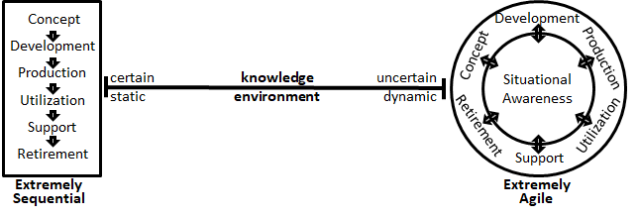
Caveat
Notes:
Although the Vee model has been in use (and remains in use in many cases) it is firmly on the left side of the knowledge environment. In that case the knowledge is certain and the environment is static (think spaceship).
On the right hand we have a changing environment (the degree to which it changes can vary) and there is a large uncertainty in knowledge.

Slide 22
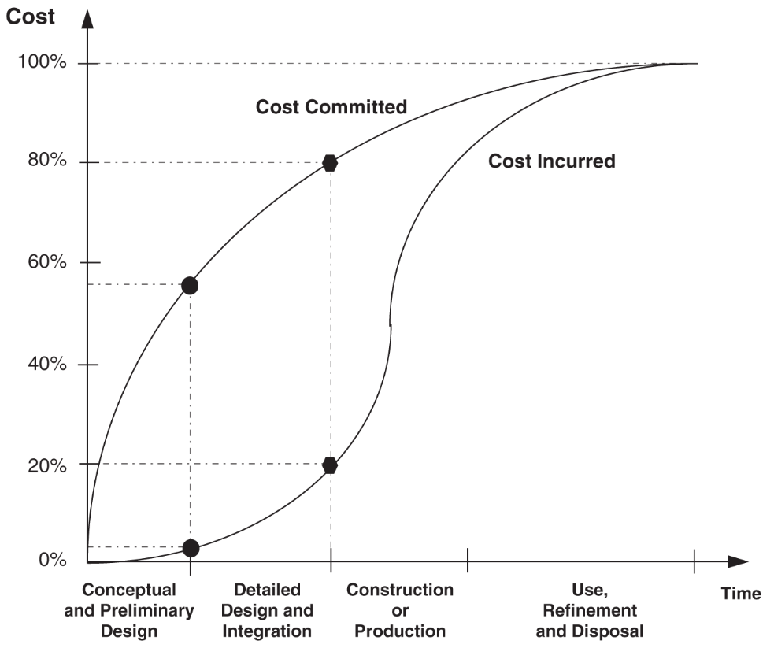
The thing about cost
Only find out here
how EXPENSIVE
Easy to commit to
expensive solution
(unknowingly)
Notes:
If you are not well versed in a technology (say microcontrollers) it is easy to commit to a technology early on (during first 20% or so of life cycle) only to find out at the 50%+ point that your choice was horribly expensive (solvable) or that it is technically not feasible (very bad – money cannot buy time). Think about your engineering design module. In the next 2 weeks you’ll start to make decisions – the results of which might only be clear 2 weeks before the exam. Wrong choices will be impossible to correct (or at the very least require significant resources).

Slide 23
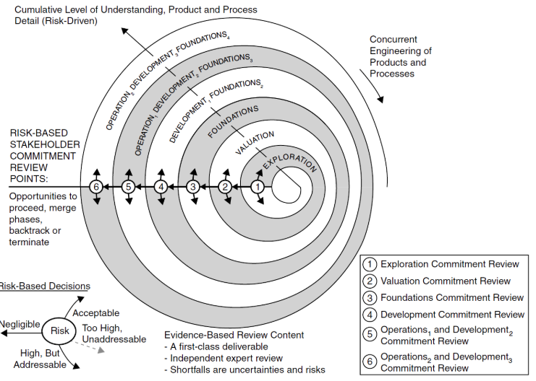
Incremental commitment spiral model (icsm)
Notes:
Think of this model as a way of only committing a little bit over time but each time getting a system that is closer to the final product. Consider a game of roulette.

Slide 24
Middle-out approach
Essentially the middle out approach starts at the pivot point of the Vee model and works both legs of the Vee at the same time. Conceptually “guess” an architecture and then ask “what can this architecture do?” (left side) and “how will I test this architecture?” (right side). However, this might take a very long time for inexperience systems engineers.
Alternative is to “gamble” and commit to a set of requirements quickly and then try to develop a system to meet those requirements as quickly as possible (and hope that it was achievable in the fist place).
In design we use a combination of the middle-out Vee and the ICSM. Well explore a bit (tech, approaches, etc) but assume at least some high-level architecture as departure point.

Slide 25
Wrapping up
Systems Engineering is a formal process
01
Aim to deliver best stakeholder value
02
Incremental development approaches help to manage risk
03
Notes:
The key here is stakeholder value. As the SE you cannot make decisions about cost (cheapest is the best) or technology (Arduino rocks) or functionality (what the device will do) without the stakeholder’s input.

Slide 26
Ponder this
What will exploration look like so that your design effort can proceed to the next phase?

